Slide 1
Stank and disease free Switching to aluminum free deodorants
By Melissa Moreno

Slide 2
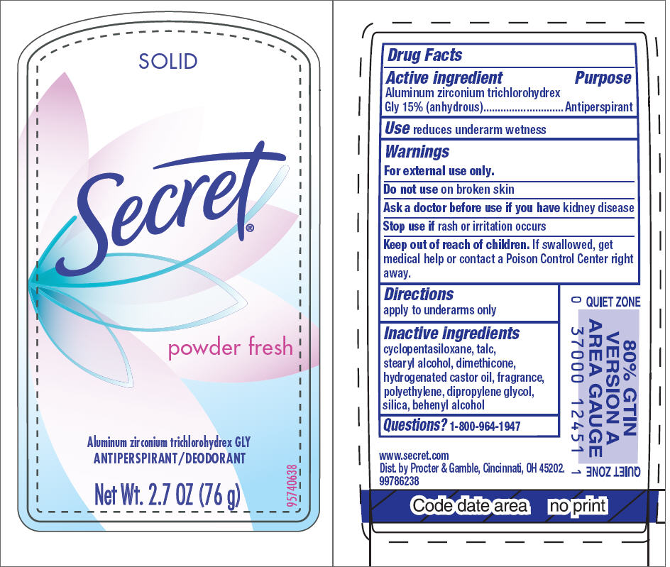
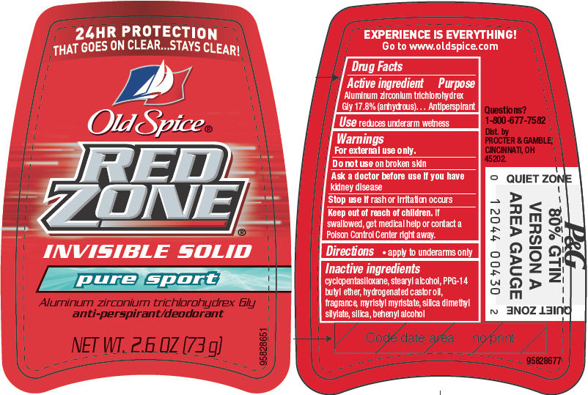
Deodorant and Antiperspirants
Antiperspirants active ingredient -- an aluminum-based compound that temporarily plugs the sweat ducts and prevents you from perspiring.
Typically, antiperspirants are coupled with a deodorant, which contains the pleasant scent that stops you from stinking.

Slide 3
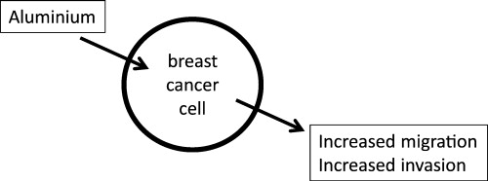
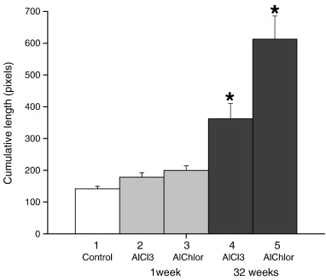
Aluminum and Research
Darbre, Philippa D, (2013) , Aluminum and breast cancer: Sources of exposure , tissue measurements and mechanisms of toxicological actions on breast biology
- Examine recent evidence linking aluminum exposure with breast cancer
- Presence of aluminum in breast may alter breast microenvironment
- disrupts iron metabolism
- oxidative damage to cellular components
- Consequences for breast epithelial cells
Darbre, Philippa D, (2013) Effect of aluminum on migratory and invasive properties of MCF-7 human breast cancer cells in culture
-MCF-7 breast cancer cell line
-Aluminum salts increase migratory and invasive properties of MCF-7 cells

Slide 4
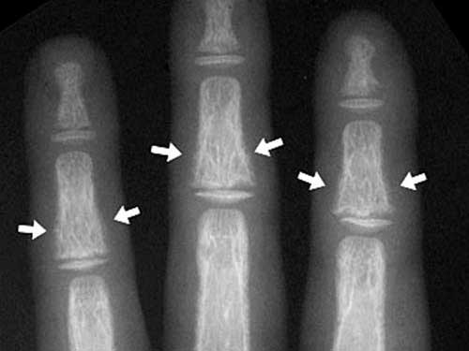
Aluminum and Research continued…
Chukwujindu M.A Iwegue (2015) Evaluation of Human Exposure to metals from some popular brands of underarm cosmetics in Nigeria
-Examined high concentrations of metals in Nigeria
-30 brands of commonly used underarm cosmetics
-High amounts of aluminum in underarm cosmetics
-Not regulated in Africa
-Found most women in Africa were not applying deodorant correctly
Malluche HH, (2002) Aluminium and bone disease in chronic renal failure
-Aluminium is absorbed by the intestines and is rapidly transported into bone
-Disrupts mineralization and bone cell growth and activity
-Toxicities result in or exacerbate painful forms of renal osteodystrophy

Slide 5
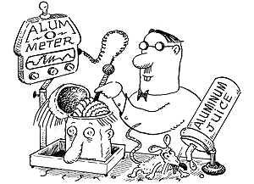
Aluminum and Research continued…
Tomljenovic L, (2011) Aluminum and Alzheimer's disease: after a century of controversy, is there a plausible link?
-Alzheimer's disease (AD) is the most prevalent neurodegenerative disease of the elderly.
-Characterized by regional specificity of neural aberrations associated with higher cognitive functions.
-Aluminum (Al) is the most abundant neurotoxic metal on earth, widely bioavailable to humans.

Slide 6

Why should I care?
The fact is many personal care products that deal with these concerns contain aluminum as an active ingredient.
If you find that your underarms are irritated, it may be an allergic reaction to the aluminum.
Aluminum has been associated with a variety of health issues.
Breast Cancer
Contact Dermatitis
Bone Disease(s)
Alzheimer’s Disease

Slide 7
Alternatives
DIY Deodorant
Ingredients
3 TB cup arrowroot powder/non-GMO cornstarch
2 TB cup baking soda
3 TB melted coconut oil
3 TB shea butter
Instructions
1. Combine baking soda and arrowroot powder/cornstarch. 2. Add four tablespoons melted coconut oil and mix with a fork. Continue adding coconut oil until the deodorant reaches your preferred consistency. 3. Transfer mixture to a jar with a tight fitting lid.
Organic or aluminum- free deodorants are not more expensive
-$5-$20
Easily available
-CVS
-Walgreens
-Publix
-Target
-Health Food Stores
Sunflower Health Food Store

Slide 8
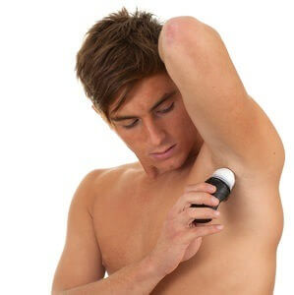
Misconceptions and Call to Action!
There is no link to aluminum concentrations and cancer/diseases i.e breast cancer.
Switching over to organic deodorants is very expensive.
Organic and/or DIY deodorants will not work as well as leading aluminum deodorants.
It is more convenient to purchase leading aluminum deodorants.

